Slide 1
Petition #4645
Zoning Board of Appeals Meeting – November 12, 2024

Slide 2
zoning Petition #4645
“Dundee renewables solar”
APPLICANT
Dundee Renewables, LLC
PROPERTY OWNER
LF4 INVESTMENT LLC
ACTION REQUESTED
A Special Use Permit in the F-Farming Zoning District to allow for the development of a commercial solar energy facility.
SUBJECT PROPERTY
West side of Boyer Road, north of Huntley Road/Longmeadow Parkway, in Dundee Township (PIN 03-06-300-002)

Slide 3
Special Use Permit Application September 25, 2024
An Application for a Special Use Permit with the Petitioner’s Findings of Fact
An ALTA/NSPS Land Title Survey dated May 29, 2024
A Noise Compliant Report dated August 27, 2024
A Site Plan dated September 19, 2024
A Decommissioning Plan
A Wetland Investigation Report dated September 4, 2024
Stormwater Memo dated September 26, 2024
An executed Agricultural Mitigation Impact Agreement with the Illinois Department of Agriculture
Results and recommendations from the Illinois Dept. of Natural Resources obtained through the Ecological Compliance Assessment Tool dated June 16, 2024
Results and recommendations from the United States Fish and Wildlife Service obtained through the Information for Planning and Consulting environmental review dated June 16, 2024
A Natural Resources Inventory Report from the Kane-DuPage Soil & Water Conservation District dated June 25, 2024
Review Letter from the Illinois State Historic Preservation Office dated June 10, 2024

Slide 4
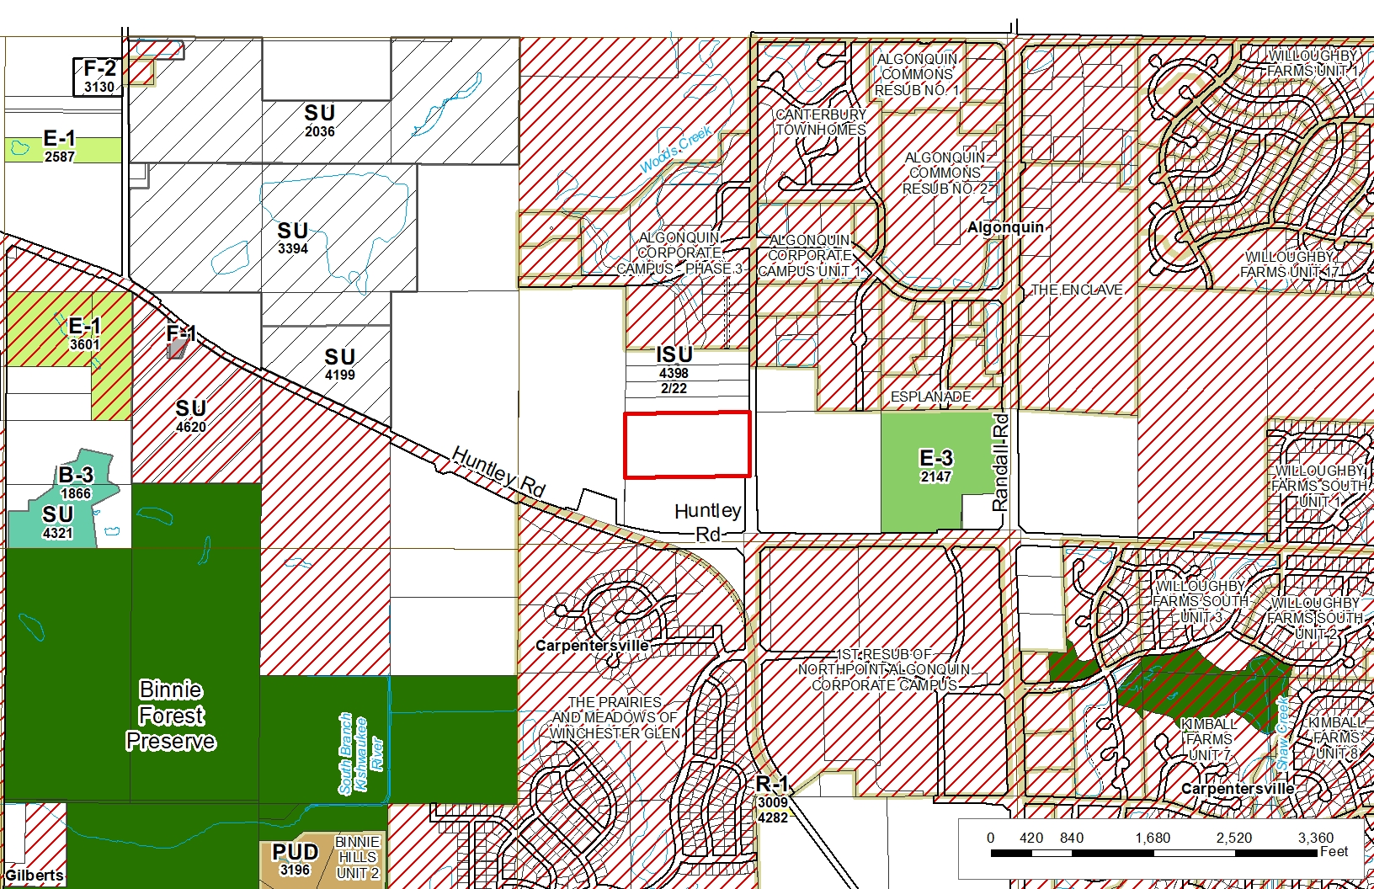
Zoning
ZONING
The subject property is currently zoned F-Farming District. Section 25-8-1-2 of the Kane County Zoning Ordinance provides that “Solar Utility” is a Special Use in the F-Farming District.

Slide 5
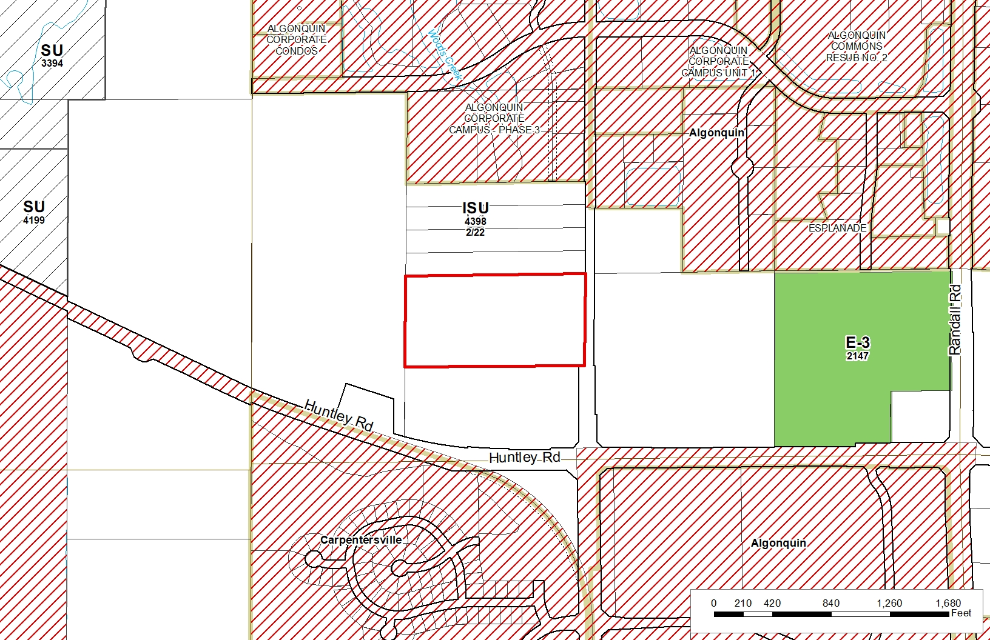
Zoning

Slide 6
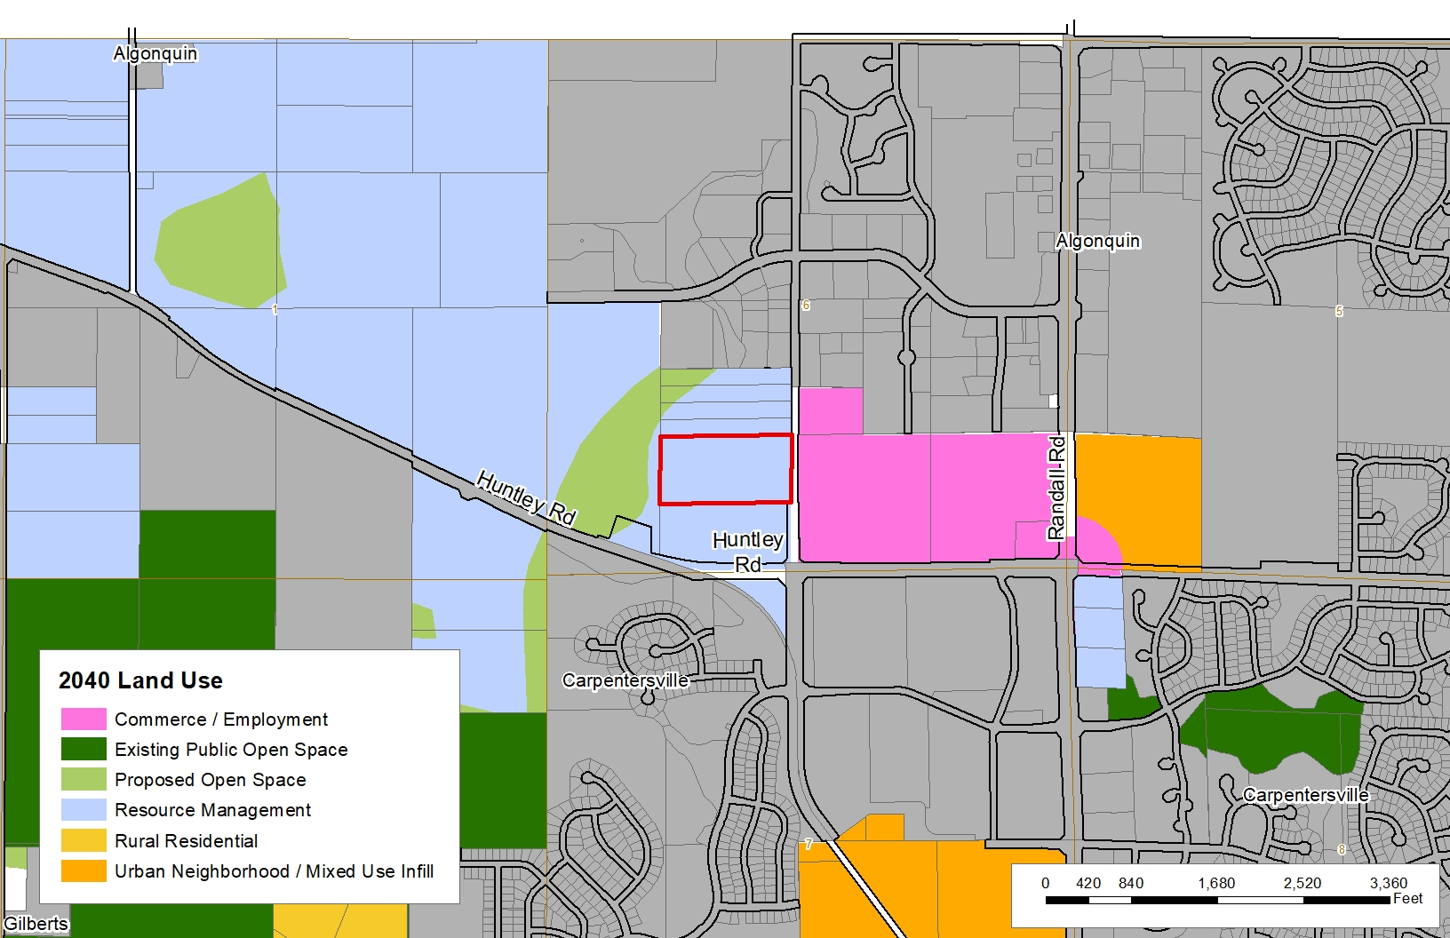
2040 Land Use

Slide 7
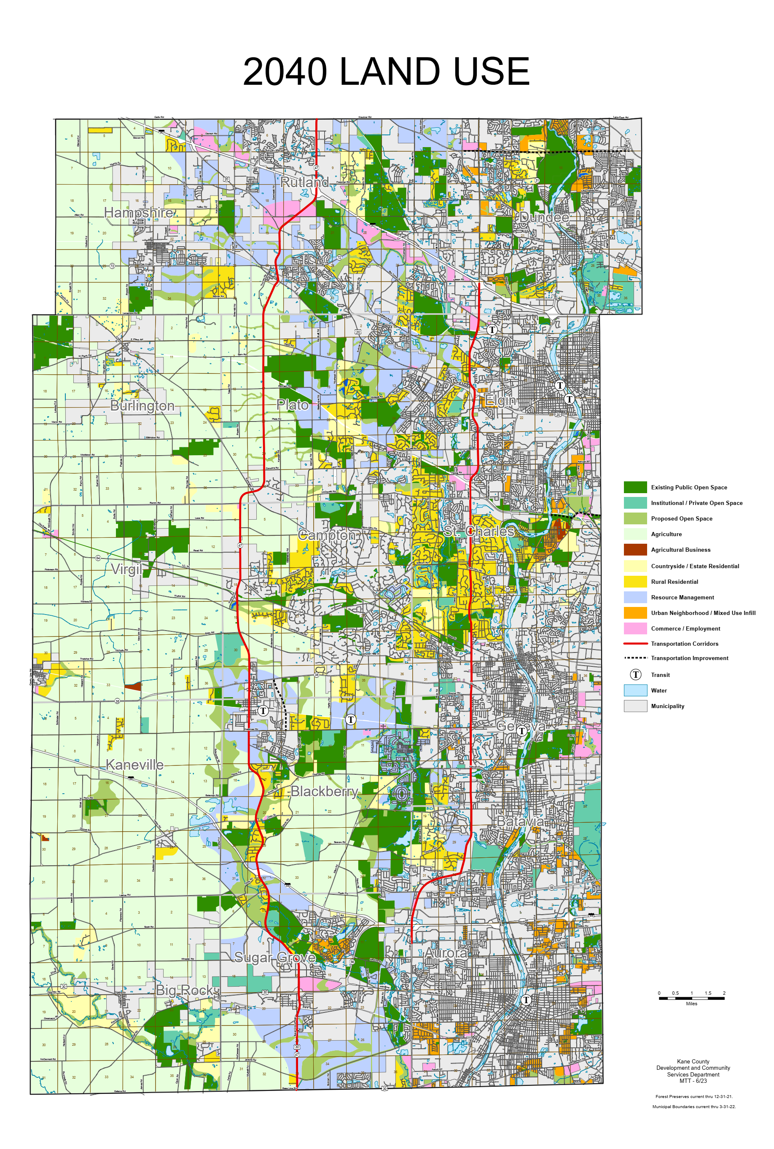
2040 Land Use Analysis
Boyer Rd. - Dundee Township – Petition #4634
2040 Planned Use: Resource Management
Characteristics of Areas Planned for Resource Management
Resource Management is a land use category that supports municipal and County compact, mixed use growth opportunities while emphasizing wise management of land and water resources
Applies primarily to land within the Critical Growth Area
Much of the growth in the Resource Management category will be the result of municipal annexations and land use decisions and, to a lesser extent, approval by the County as unincorporated development

Slide 8
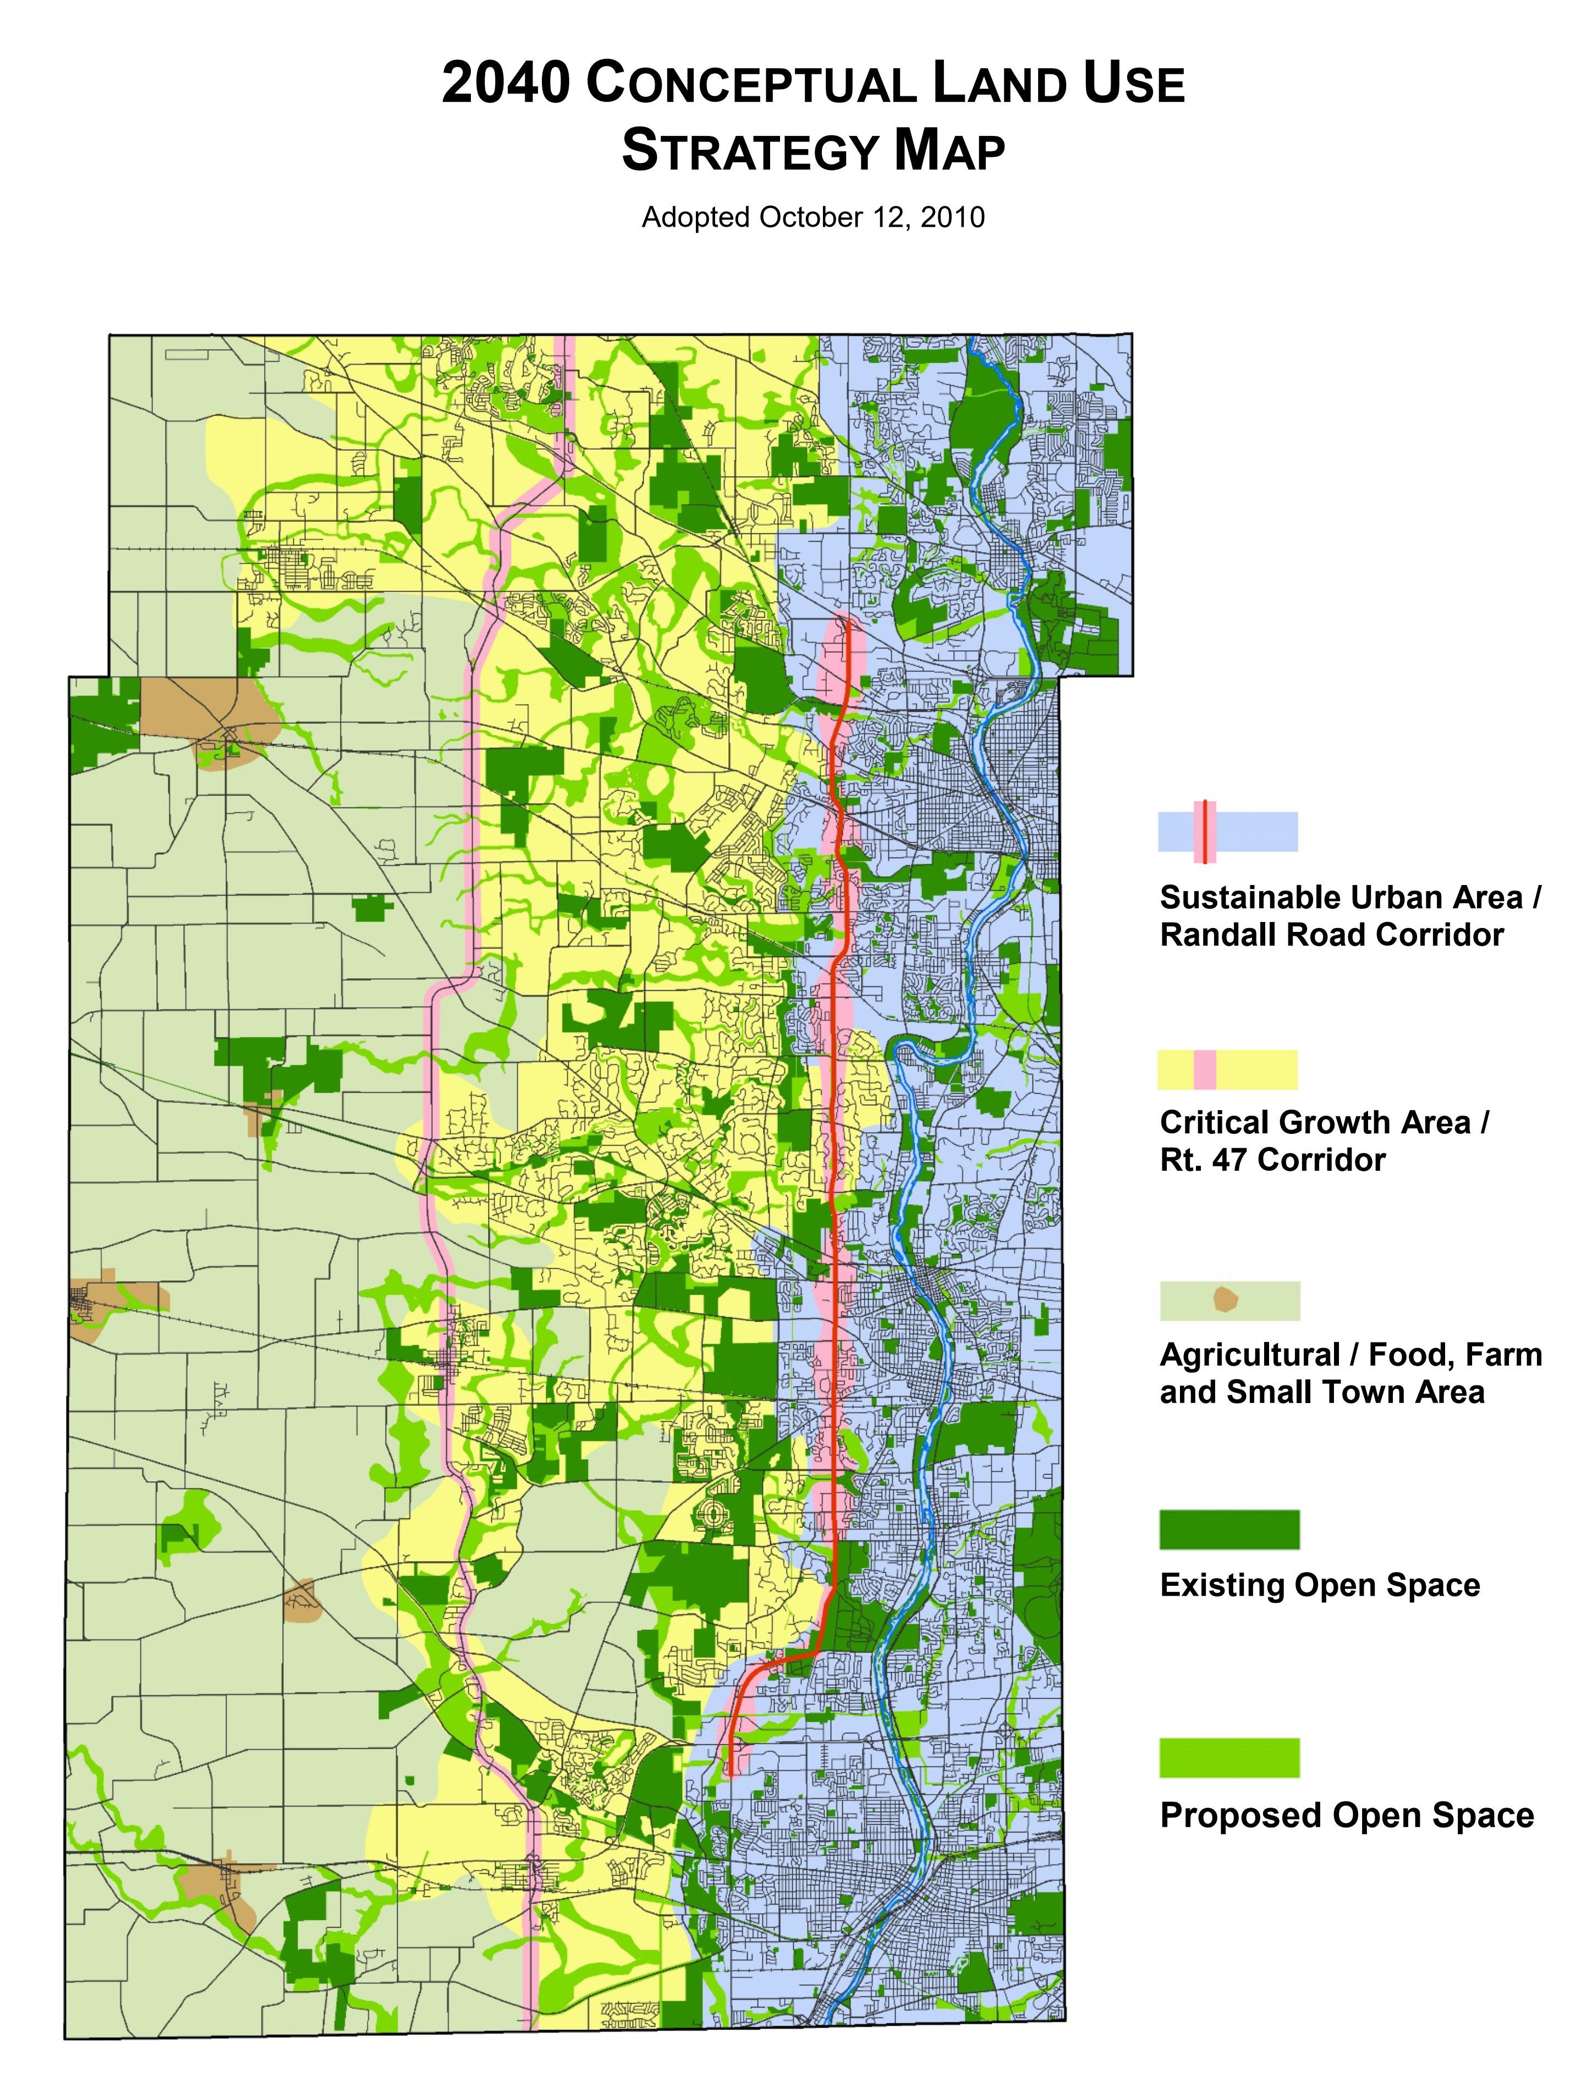
2040 Conceptual Land Use Strategy
Boyer Rd. - Dundee Township – Petition #4634
Land Use Strategy Area:
Critical Growth Area / Rt. 47 Corridor
Core Themes
The Critical Growth Area continues to be where Kane County and the fast growing municipalities of the past two decades face the greatest challenges to sensible, managed growth
The Critical Growth Area is characterized by diversity and mix of planned municipal development, expanded transportation opportunities, additional open space initiatives, natural resource driven decision-making and healthy living
The Conceptual Land Use Strategy Map:
A general land use map that divides the county into 3 major geographic corridors, each with unique land resources, development patterns, and planning opportunities.

Slide 9
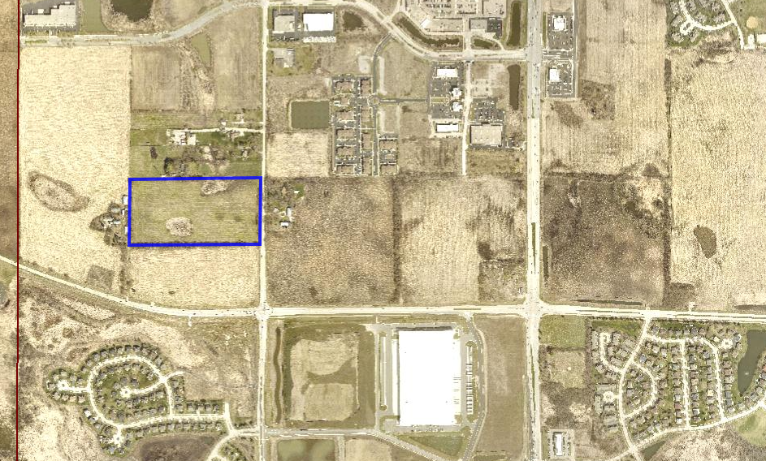
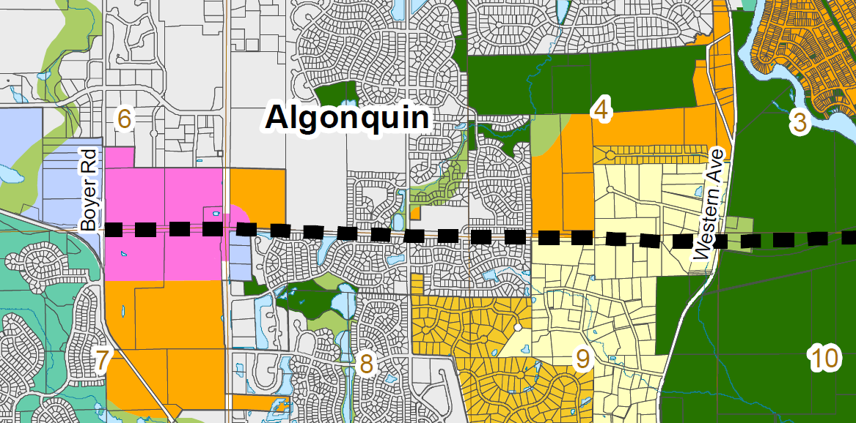
<< LONGMEADOW PARKWAY >>
Longmeadow Parkway Context Map
Subject Property
Subject Property

Slide 10
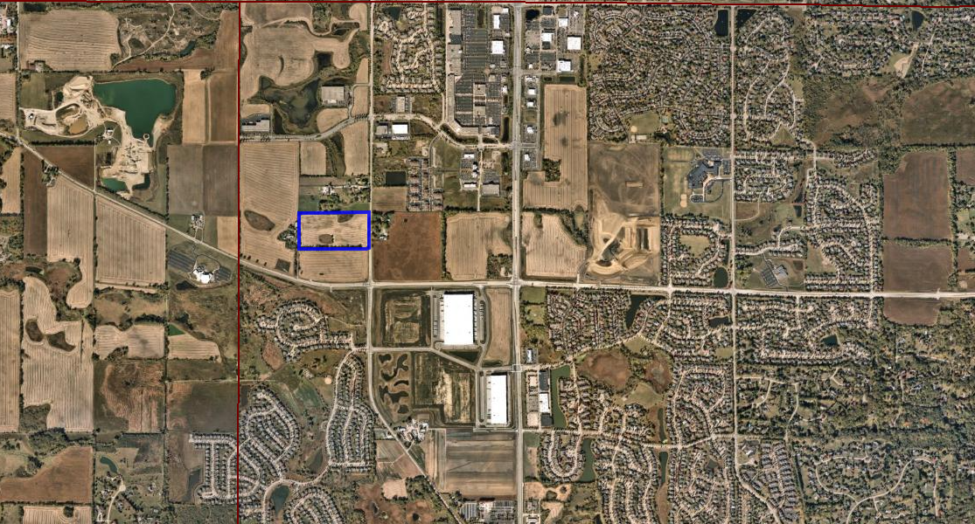
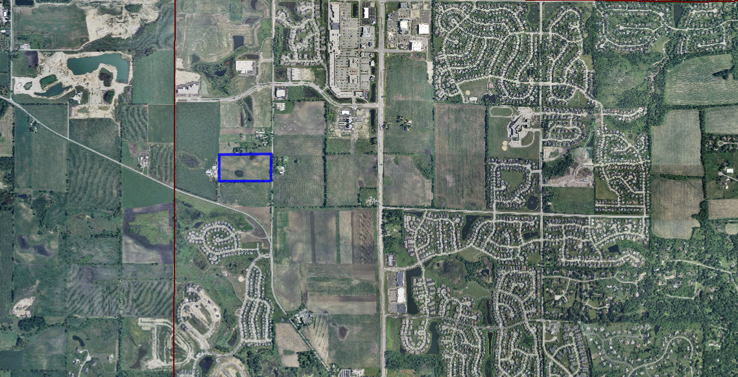
2024
Longmeadow Parkway
2008

Slide 11
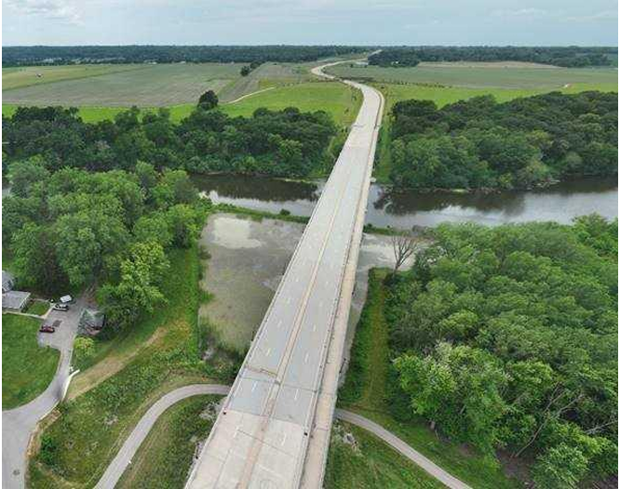
Longmeadow Parkway Bridge Corridor Opens to the Public
The Longmeadow Parkway Fox River Bridge Corridor, spanning parts of the Villages of Algonquin, Carpentersville, and unincorporated areas of Kane County, has officially opened to the public.
The cornerstone of the $200 million project is a new bridge that provides an additional route over the Fox River in northern Kane County. The entire corridor stretches 5.6 miles, from Huntley Road to Route 62, and includes a bike and pedestrian path connecting to the Fox River Trail.
The opening was celebrated with a ribbon-cutting event attended by over 175 people including Governor JB Pritzker, Kane County elected officials, members of the Kane County Division of Transportation, state lawmakers, and local leaders.
“With the Longmeadow Parkway Bridge Corridor, we’re not just building a bridge over the Fox River; we’re creating a vital artery that connects our communities, enhances regional mobility, and drives economic growth,” said Kane County Board Chairman Corinne Pierog. “This project transforms a barrier into a pathway of opportunity and progress for all who travel through our county.”
Originally, Kane County planned to fund the bridge construction with tolls. However, over the past two years, the County successfully secured an additional $30 million in state funding to cover the costs. As a result, the bridge was completed without imposing tolls.
Media Release 8/29/24

Slide 12
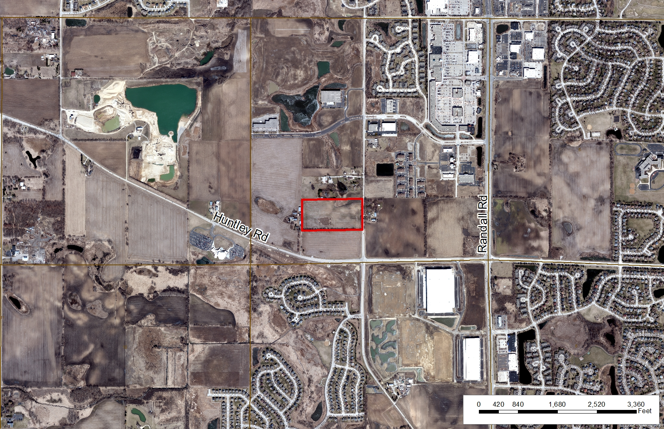

Slide 13
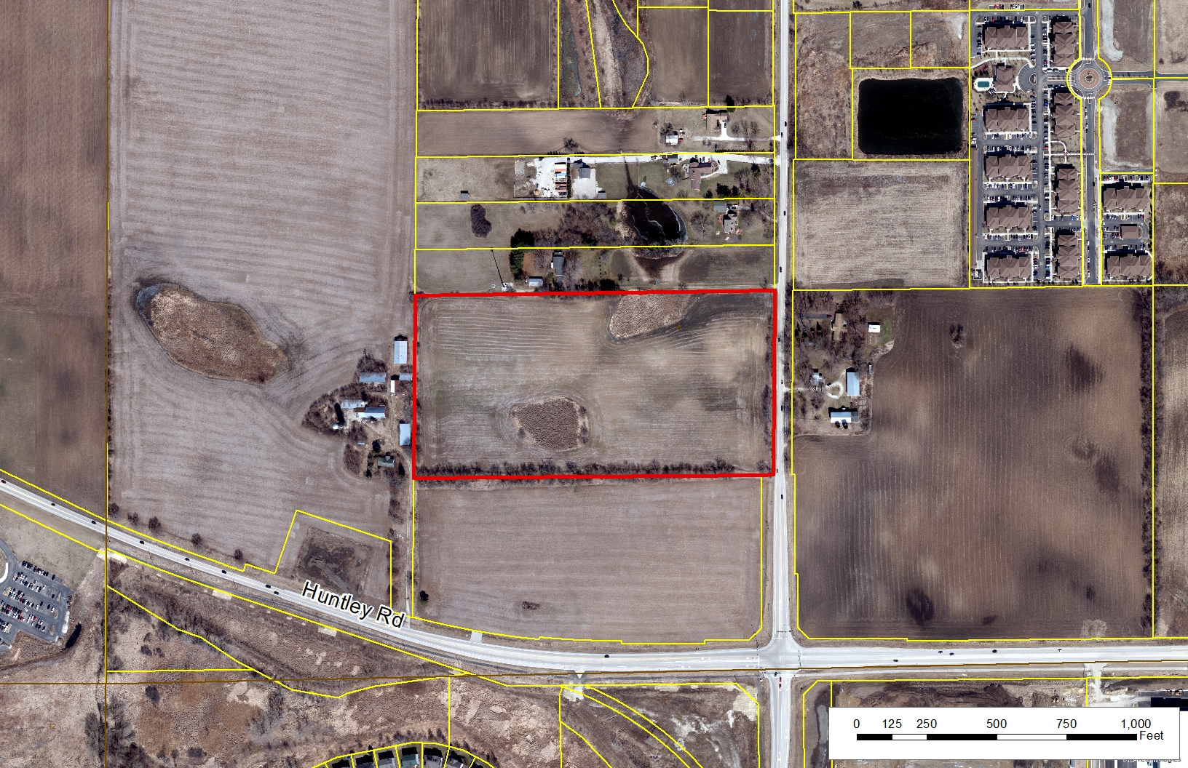

Slide 14
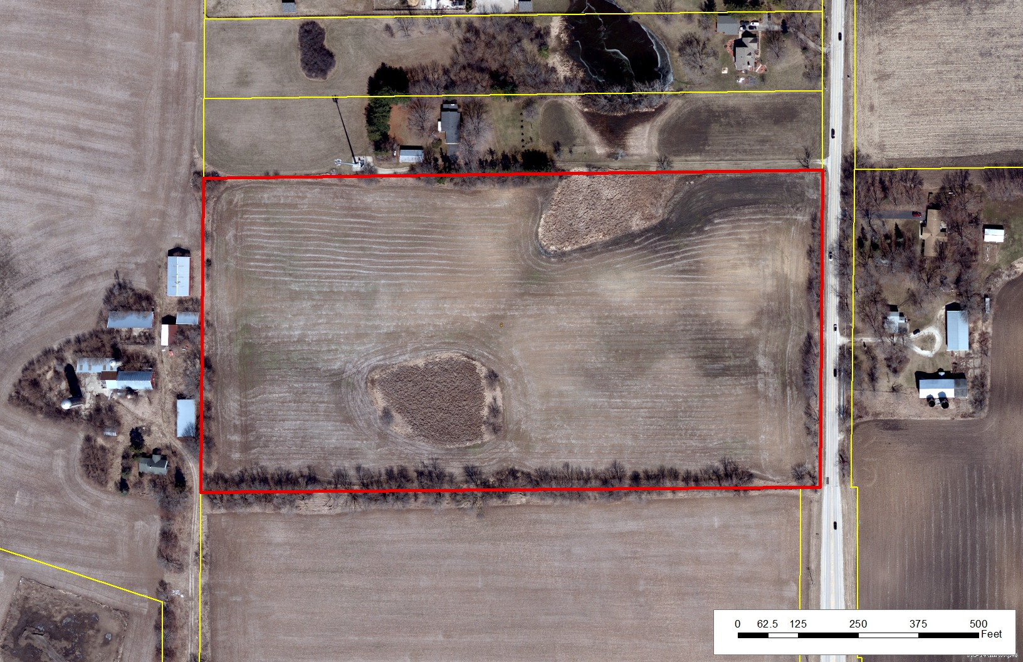

Slide 15
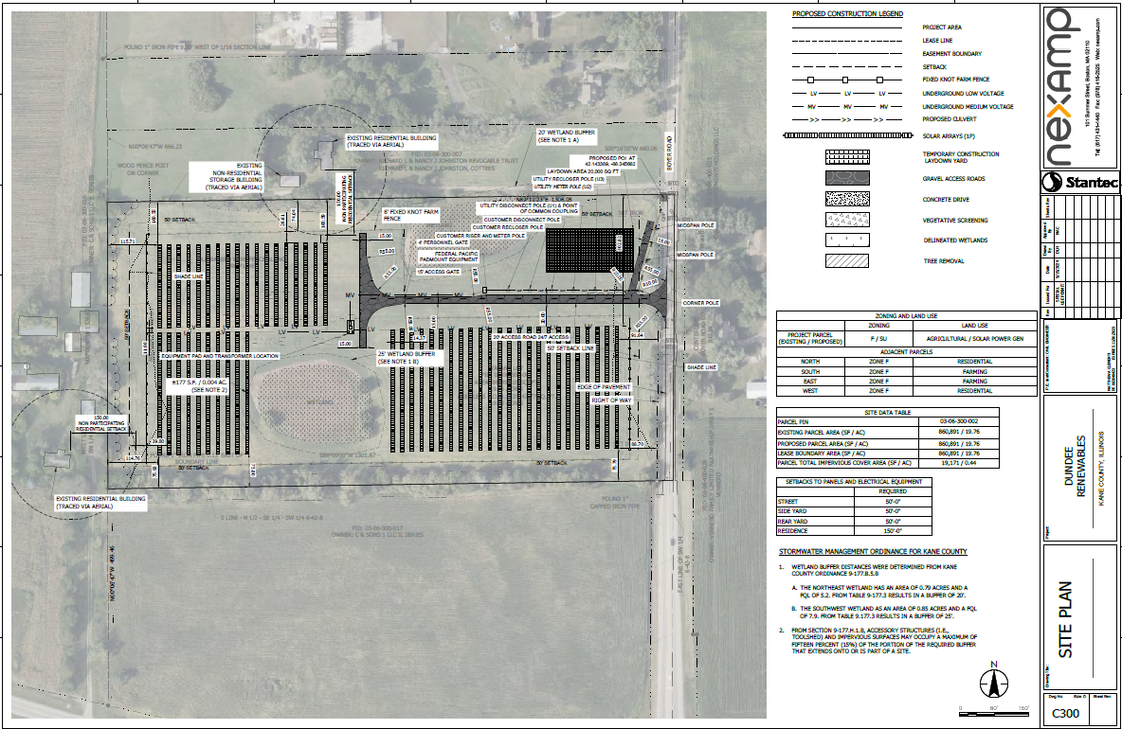
Site Plan

Slide 16
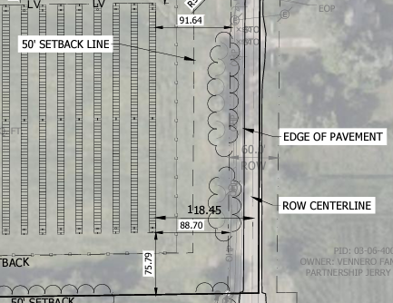
Site Plan – ROW Centerline Setback (118’)

Slide 17
Setbacks Requirements
Code Requires:
Site Plan Provides:
The Commercial Solar Energy Facility shall be sited as follows, with setback distances measured from the nearest edge of any component of the facility:
(1) Occupied Community Buildings and Dwellings on Nonparticipating Properties: one hundred fifty (150) feet to the nearest point on the outside wall of the structure.
(2) Boundary Lines of Participating Property: None.
(3) Boundary Lines of Nonparticipating Property: fifty (50) feet to the nearest point on the property line of the nonparticipating property.
(4) Public Road Rights-of-Way: fifty (50) feet to the nearest edge of the public road right-of-way.
Approx. 88’ SETBACK FROM EXISTING ROAD ROW TO SOLAR PANELS
Approx. 118’ SETBACK FROM ROW CENTERLINE TO SOLAR PANELS
50’+ SETBACK FROM PROPERTY LINE TO SOLAR PANELS
150' SETBACK FROM NON-PARTICIPATING RESIDENTIAL PROPERTIES

Slide 18
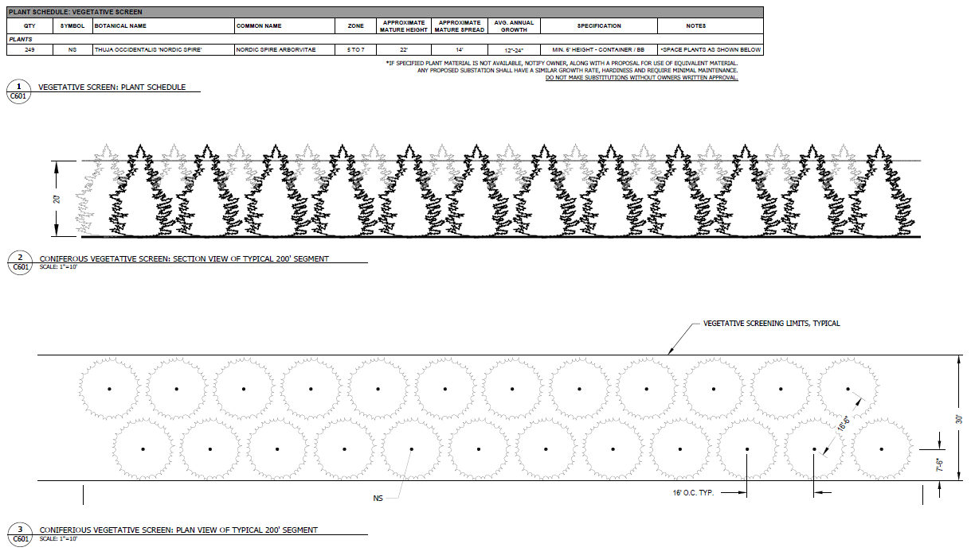
Landscaping/Vegetation
Vegetative Screening Requirements
A vegetative screen shall be provided for any part of the Commercial Solar Energy Facility that is visible to Non-participating Residence(s).
The landscaping screen shall be located between the required fencing and the property line of the participating parcel upon which the facility sits.
The vegetative screening shall include a continuous line of native evergreen foliage and/or native shrubs and/or native trees and/or any existing wooded area and/or plantings of tall native grasses and other native flowering plants.

Slide 19
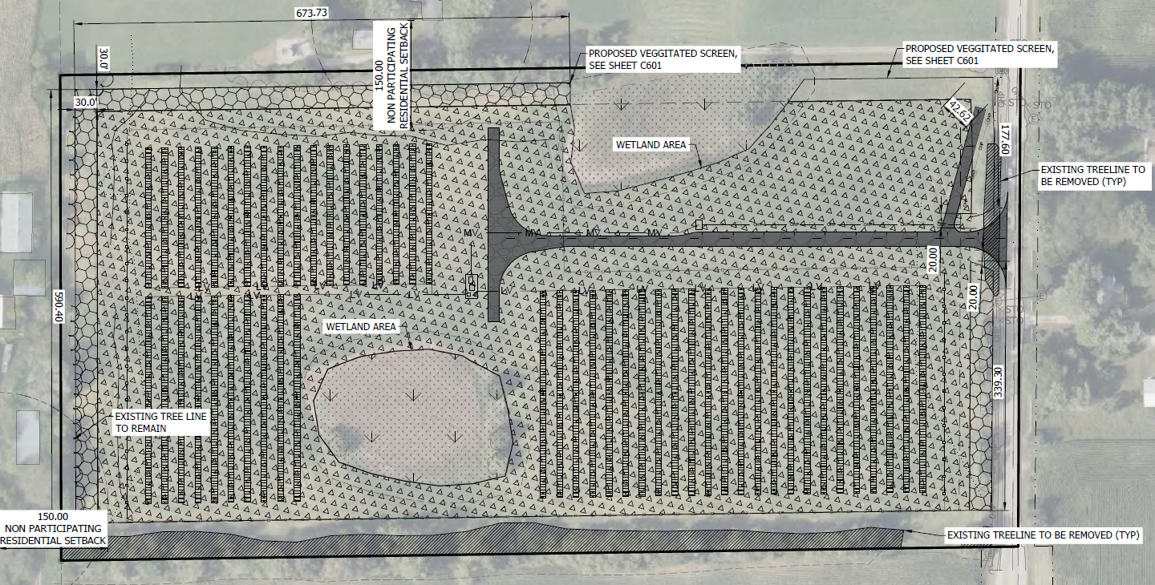
Landscape Plan

Slide 20
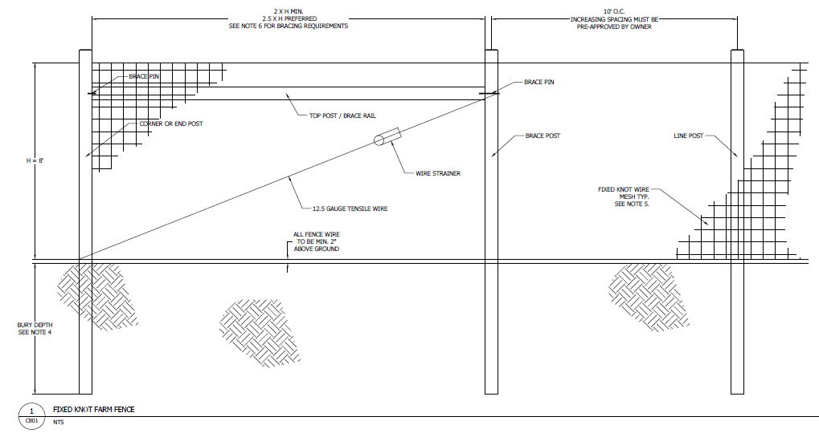
Fence Detail Fencing: A fence of at least eight (8) feet and not more than twenty-five (25) feet in height shall enclose and secure the Commercial Solar Energy Facility.

Slide 21
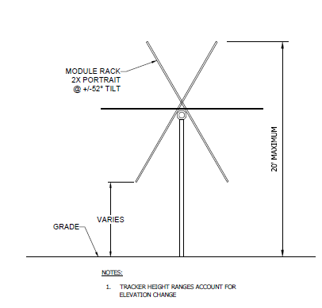
Racking Structure Detail Height: No component of a solar panel, cell or modules may exceed twenty (20) feet in height above the ground at full tilt.

Slide 22
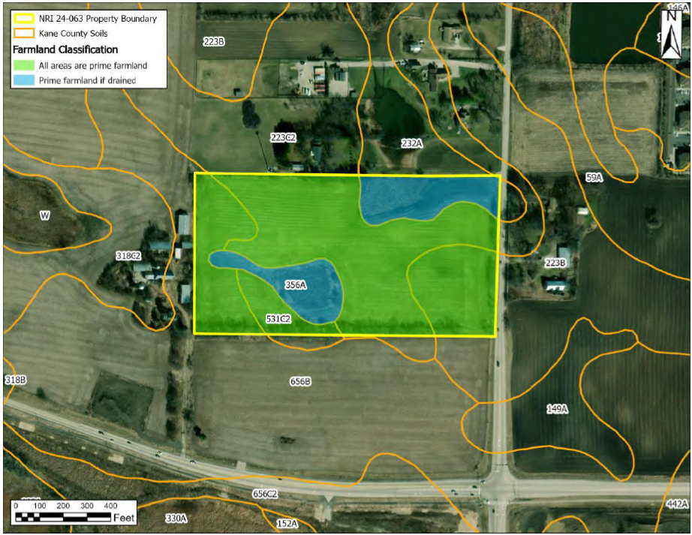
NRI Report – Prime Farmland Map
LESA SCORE:
LESA is designed to determine the quality of land for agricultural uses and to assess a site for long term agricultural economic viability. The LESA is a 100-point maximum numerical value based on two parts – Land Evaluation (LE) and Site Assessment (SA). The LE is based upon the inherent ability of the soils of a parcel to produce commonly grown crops. The LE counts as 1/3 of the total score. The SA is a value based on the proximity of the parcel to agricultural areas. Parcels further from developed areas rank higher for protection. The SA counts for 2/3 of the LESA score.
The LE value for this site is 26 and the SA value is 35 for a total LESA score of 61.
This score represents Low Protection effort warranted.

Slide 23
KDOT & Dundee TWP
Memo from the Kane County Department of Transportation dated October 10, 2024 stating they will require the 50’ west right-of-way setback from the Boyer Rd centerline and then the 50’ statutory setback for the solar arrays for an ultimate setback of 100’ from the Boyer Rd centerline. Dundee Township will permit temporary and final accesses.
Memo from the Dundee Township dated October 7, 2024 stating the Village of Algonquin has planned improvements for that section of Boyer Road and coordination must be established with Algonquin; an access permit is required from Highway Commissioner; and any work in the Right of Way requires a permit from Highway Commissioner.

Slide 24
Kane County Water Resources Stipulations
Water Resources will require a stormwater permit for this development.
An Engineer’s report will be required. Should the site introduce more than 25,000 sq ft of impervious area or more than 3 acres of disturbance, stormwater detention will be required. This impervious area is calculated cumulatively since 2002 for a site as per the Stormwater Ordinance. The Engineer’s report must demonstrate that the peak flow for the site with the proposed development is not increased, stormwater detention may be required for the development to ensure this. Any required Stormwater Detention Management will require a viable outfall and may require off-site work.
Should the site introduce more than 5,000 sq ft of impervious, a BMP will be required for all impervious surfaces.
A calculation for disconnected impervious area, created by the panels, will be required. A Best Management Practice will be required to encourage infiltration of runoff within the site.
A drain tile study will be required, including upstream and downstream tile systems that rely on the drain tiles within the site. Water Resources is looking for the protection of the tile system that is in place, including but not limited to replacement in kind and observation and cleanout structures.
Plantings within the development will not interfere with drain tiles. Planting plan should address the placement of vegetation and trees with long root systems that can interfere with tile systems and cause off site issues including surcharged drain tiles and blow outs of the drain tile systems.
Soil samples shall be taken every 2 years from the site and analyzed for physical, chemical, and biological properties to demonstrate the soil health within the solar installations.
80% vegetative coverage for plantings will be a requirement for the site.
A Wetland Delineation will be required. Any Wetland Impacts must be mitigated.
Any fill in depressional areas will require Compensatory storage. Including fill created by solar racking.
Floodplain, Wetland, Compensatory Storage, BMPs and Stormwater Management must be placed in a Conservation or Drainage Easement.

Slide 25
Petition Opposition – Village of Algonquin Letter dated October 30, 2024
The Village of Algonquin is in the process of engineering the reconstruction of Boyer Road in partnership with Dundee Township. The Developer of the Commercial Solar Energy Facility shall:
Extend the right-of-way forty feet (40’) from the existing centerline of Boyer Road to accommodate the Boyer Road reconstruction.
Install an eight-foot (8’) wide multi-use asphalt path per the Village of Algonquin standards within the right-of-way along the frontage of the Commercial Solar Facility or provide the Village of Algonquin the appropriate compensation covering the cost of the improvement.
Install a sixteen-inch (16”) ductile iron water main within the Boyer Road right-of-way along the frontage of the Commercial Solar Energy Facility or provide the Village of Algonquin the appropriate compensation covering the cost of the improvement.
Provide the appropriate easements on the Subject Property for maintenance if the multiuse path and utilities cannot be constructed in the new Boyer Road right-of-way.
All existing and new utilities along Boyer Road and on the Subject Property shall be buried. This is a requirement of the Algonquin Village Code.
The driveway apron shall be constructed of concrete or asphalt from the edge of the pavement to the right-of-way and shall accommodate the constructed or future multi-use path. This is a requirement of the Algonquin Village Code.
All planned and future buildings on the Subject Property shall have a one-hundred percent (100%) masonry exterior façade and shall be no more than fifteen feet (15’) in height. All roof-mounted mechanical equipment shall be screened by a masonry parapet wall and not visible from adjacent properties. This is a requirement of the Algonquin Village Code.
The thirty-foot (30’) wide vegetative screen referenced on Sheet C601, as prepared by Stantec, and last revised September 19, 2024, shall be installed 100% around the perimeter property, except where prohibited in wetland areas. Special attention shall be paid to the installation along the east and south sides of the property which are visible from public roadways. Also note that the Village of Algonquin has been named Tree City for the 28th consecutive year and the Algonquin Village code requires at a minimum the replacement of the total DBH (diameter at breast height) of all trees removed.
Native landscaping including pollinator planting shall be provided for all landscaped areas within the site. This is a requirement of the Algonquin Village Code.

Slide 26
Dundee Renewables – Proposed Conditions in response to VOA
Applicant’s final site design shall accommodate a future expansion of the Boyer Road right-of-way of 40 feet from the current centerline of Boyer Road. (KDOT requires 50’ from the ROW centerline + 50’ from that point to nearest solar panels; 100’ total from centerline to panels)
All new interconnection facilities to be installed and owned by the Applicant as part of the solar project shall be buried underground. This condition shall not apply to existing or new utilities installed or to be installed by any public utility including Com Ed.
The solar project driveway from the edge of the pavement to the right-of-way shall be constructed of concrete or asphalt.
The Applicant shall install vegetative screening as shown in the vegetative screening plan in the application and shall also install vegetative screening along the south lot line of the subject property.
Native landscaping including pollinator planting shall be provided for all landscaped areas within the fenced area of the site.

Slide 27
Special Use Permit – Findings of Fact
The six factors for granting a Special Use per the Kane County Zoning Ordinance (Section 4.8-2)
That the establishment, maintenance or operation of the Special Use will not be unreasonably detrimental to or endanger the public health, safety, morals, comfort or general welfare.
That the Special Use will not be injurious to the use and enjoyment of other property in the immediate vicinity for the purposes already permitted, not substantially diminish and impair property values within the neighborhood.
That the establishment of the Special Use will not impede the normal and orderly development and improvement of surrounding property for uses permitted in the district;
That adequate utility, access roads, drainage and/or other necessary facilities have been or are being provided;
That adequate measures have been or will be taken to provide ingress and egress so designed as to minimize traffic congestion in the public streets and roads;
That the Special Use shall in all other respects conform to the applicable regulations of the district in which it is located, except as such regulations may in each instance be modified by the Kane County Board pursuant to the recommendations of the Kane County Zoning Board of Appeals.

Slide 28
Meeting Schedule:
Regional Planning Commission: N/A
Zoning Board of Appeals: November 12, 2024
Development Committee: November 19, 2024
Kane County Board: December 10, 2024
Petition 4645, the subject of this public hearing, will be considered by the Kane County Development Committee at its upcoming meeting currently scheduled for 10:30 a.m., Tuesday, November 19, 2024, in the County Board Meeting Room, Building A, 2nd Floor, of the Kane County Government Center, 719 S. Batavia Ave., Geneva, Illinois. Persons in favor of or in opposition to this petition who wish to speak before the Development Committee must signify their intention to do so by signing a sheet provided for such purpose at the meeting at which such petition is to be considered.
Petition 4645, the subject of this public hearing, will be considered by the County Board at its upcoming meeting currently set for 9:45 a.m., Tuesday, December 10, 2024 in the County Board Meeting Room, Building A, 2nd Floor, of the Kane County Government Center, 719 S. Batavia Ave., Geneva, Illinois. Persons in favor of or in opposition to this petition who wish to speak before the County Board must file their intention to do so with the Zoning Enforcement Officer no later than the Friday preceding the County Board meeting at which the petition is to be considered.

